Slide 1
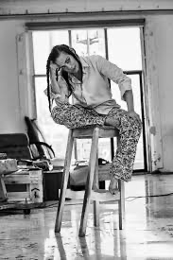
Ellen Gallagher
What is crucial to my making of a language and a cosmology of signs is the type of repetition that is central to a lot of the music I am listening to right now. . . . I start off with a limited class of signs and, like stacking in music, I chop and revisit the changes to build structure.
—Ellen Gallagher
By: Samantha De Los Santos

Slide 2
Bio:
Ellen Gallagher was born on December 16th 1965 (54 years old) in Providence, Rhode Island. Ellen Gallagher lives and works in New York and Rotterdam, Holland (Europe). She attended Oberlin College and the School of the Museum of Fine Arts, Boston and then later an Art School in Maine.
She is American, her ethnicity stems from her father who is African from (Cape Verdean) and mother who is Irish. Her mother raised both her and her sister on her own.
Gallagher’s work often contains deeper meanings about race and stereotypes, particularly for African Americans. The artist’s aesthetic has been influenced by the Minimalist style of painter Agnes Martin, and the repetition in writings by Gertrude Stein.
Today, her works are held in the collections of the Art Institute of Chicago, The Museum of Modern Art in New York, and the National Galleries of Scotland in Edinburgh, among others.

Slide 3
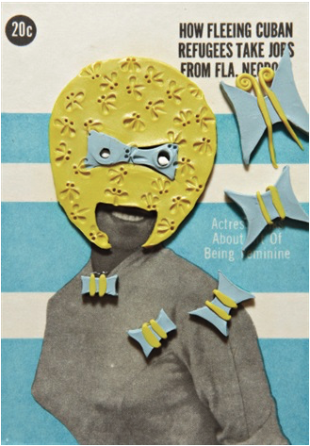
“Ruby Dee”
Ruby Dee, 2005
Photogravure with aquatint in colors and hand-shaped plasticine elements, on multilayered paper, the full sheet,
6 × 4 in
15.2 × 10.2 cm
Notes:
Like most advertising, they play the personal transformation card, telling you how you can look better, act better, smell better, be better, which really means not be offensive, which, naturally, you are.

Slide 4
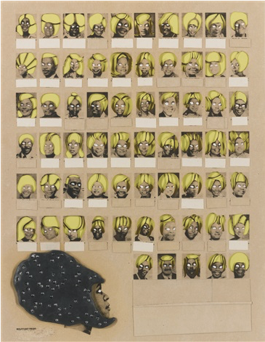
“Bouffant Pride”
Bouffant Pride, 2003
Photogravure with die-cuts, collage, paint, Plasticine, and toy eye additions, on rag paper, the full sheet.
13 1/2 × 10 1/2 in
34.4 × 26.7 cm
Edition 1/20 + 4AP
Notes:
Her wig ladies are fugitives, conscripts from another time and place liberated from the musty, yellowed "race" magazines of the past. With photogravure, plasticine, paint, ink, toy eyeballs, scissors, these icons are transformed from and back into the paper that has held them captive for decades." The magazine once promised to beautify the average reader
Gallagher modified advertisements using a range of interventions as a way of commenting on stereotyping and the anxieties surrounding the formation of racial identity. These interventions tend to exaggerate, distort or hide the black models’ features and include blanking out eyes with paint, adding toy eyes, imposing elaborate plasticine wigs over hair or covering faces with patterns and masks.

Slide 5
Inspo
Her work for me is all about wit, skill, craftsmanship and quality of ideas are like no other and unique to her interpretation of our world and its history. Ellen Gallagher executes her pieces in a playful way as well .
She encourages the audience to make these brilliant connections of her pieces in a form of satire that present issues of race and gender. Manipulating advertisements in the 1930s- 1960s that were targeted at black women and men
From afar, the work appears abstract and minimal; upon closer inspection, googly eyes, reconfigured wigs, tongues, and lips of minstrel caricatures multiplying in detail
The quote “A rose is a rose is a rose” repeats and reads like a play on words. This quote is a form of iteration frequently employed by Gertrude Stein (1874-1946), an innovator and pioneer in American literature. It was the writer’s literary style that influenced Ellen Gallagher to reflect the ideas of repetition and replacement in her own artistic creations.

Slide 6
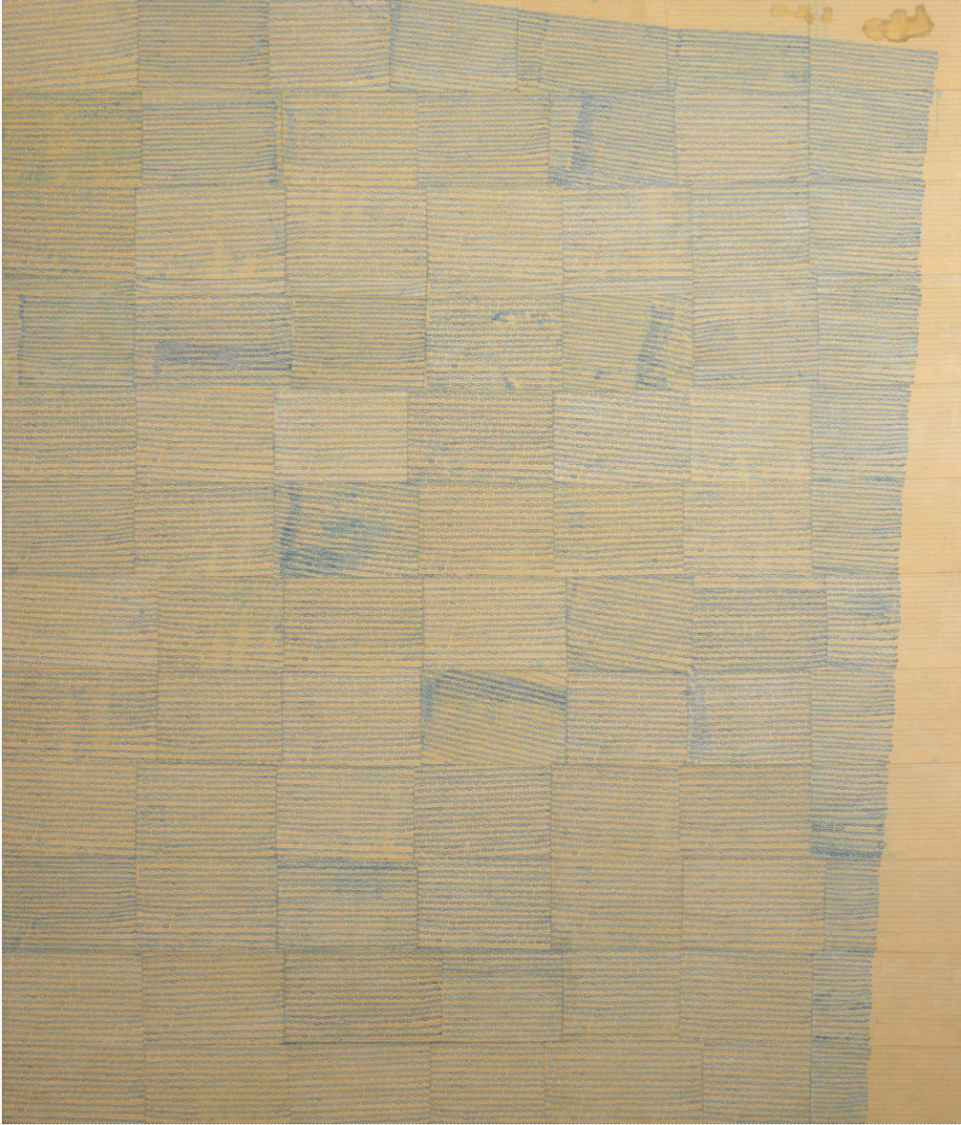
“Paper Cup”
Ink on paper on canvas
Support: 2135 × 1830 × 41 mm
1996
Notes:
A large scale painting, this work comprises 12 rows of penmanship paper, totaling 84 pieces of paper, glued to the canvas, while the canvas was wet, creating a bubbled, wrinkled appearance. On the paper, Gallagher used blue ink to create small lips, which represent stereotypes of African-Americans

Slide 7
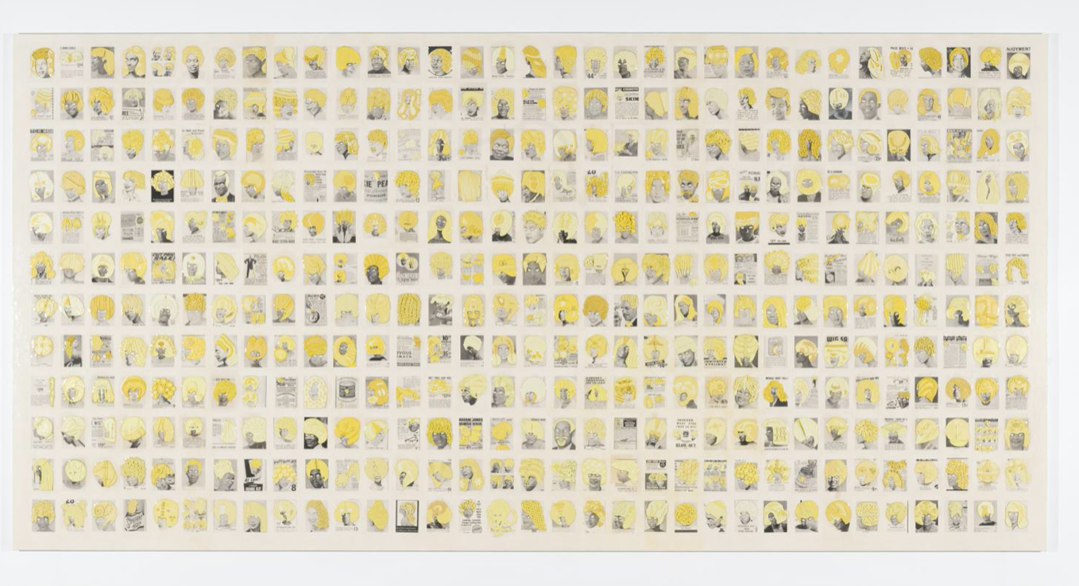
“Pomp-Bang”
Ellen Gallagher, American, b. 1965
Pomp-Bang, 2003
Plasticine, ink, and paper mounted on canvas
96 × 192 in. (244 × 488 cm)
Collection Museum of Contemporary Art Chicago, Joseph and Jory Shapiro Fund by exchange and restricted gift of Sara Szold, 2004.19
Photo: Nathan Keay, © MCA Chicago
Notes:
In POMP-BANG Gallagher works from the edifice of the grid, colonizing its autonomous structure and undoing its conformity from within. Across this massive eight-by-sixteen-foot canvas, 396 individual pages jostle for attention. One strains to see in parallax, as to take in the painting as a whole is to miss the delicious specificities of the distinct textual grounds or the quirky humor of the stylized plasticine wigs. The facticity of the newsprint thus cedes to the fantasy of Gallagher's inscriptions, while the labor involved in both the production of the painting and the social construction that provides its material support underlines their mutual impossibility. Eventually, then, this series will chart anew so many returns of the repressed--figures held too long against their will. But even in POMP-BANG alone, we can begin to read the ransom note Gallagher is subtly drafting.

Slide 8
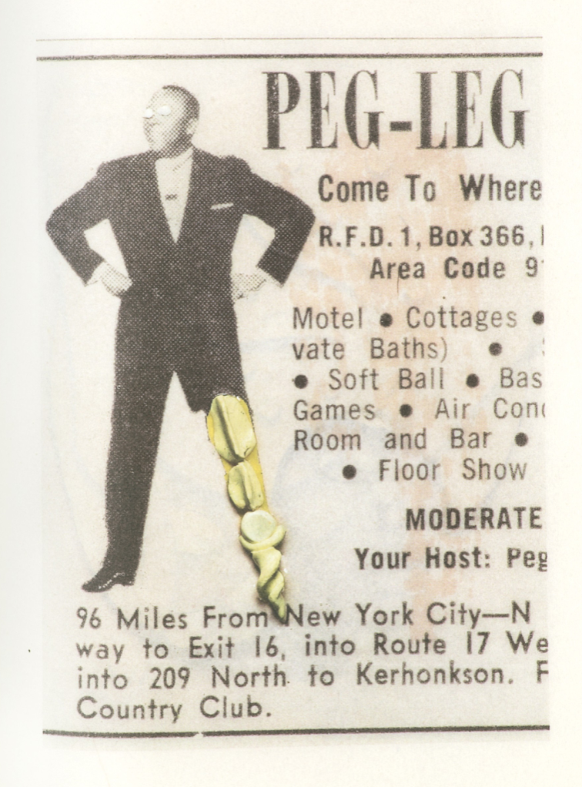
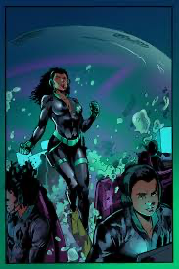
Dive Deep
By fusing narrative modes including poetry, film, music, and collage, she recalibrates the tensions between reality and fantasy—unsettling designations of race and nation, art and artifact, and allowing the familiar and the arcane to converge.
Starting again with squares of paper on canvas, she added more geometric shapes, creating a textured terrain that she built up with cut rubber. She further inscribed and collaged aleatory motifs from mid-century American race magazines and other sources, then painted the canvas in layers of black enamel. With thick, reflective surface Gallagher suggests that the psychosis of race relations is embedded in the history of Western abstraction.
In Watery Ecstatic, she invents complex biomorphic forms that she relates to the mythical Drexciya, an undersea kingdom populated by the women and children who were the tragic casualties of the transatlantic slave trade. Cutting into thick paper in her own version of scrimshaw & the practice of carving whale bones
Notes:
Scrimshaw: engravings and carvings done by bone

Slide 9
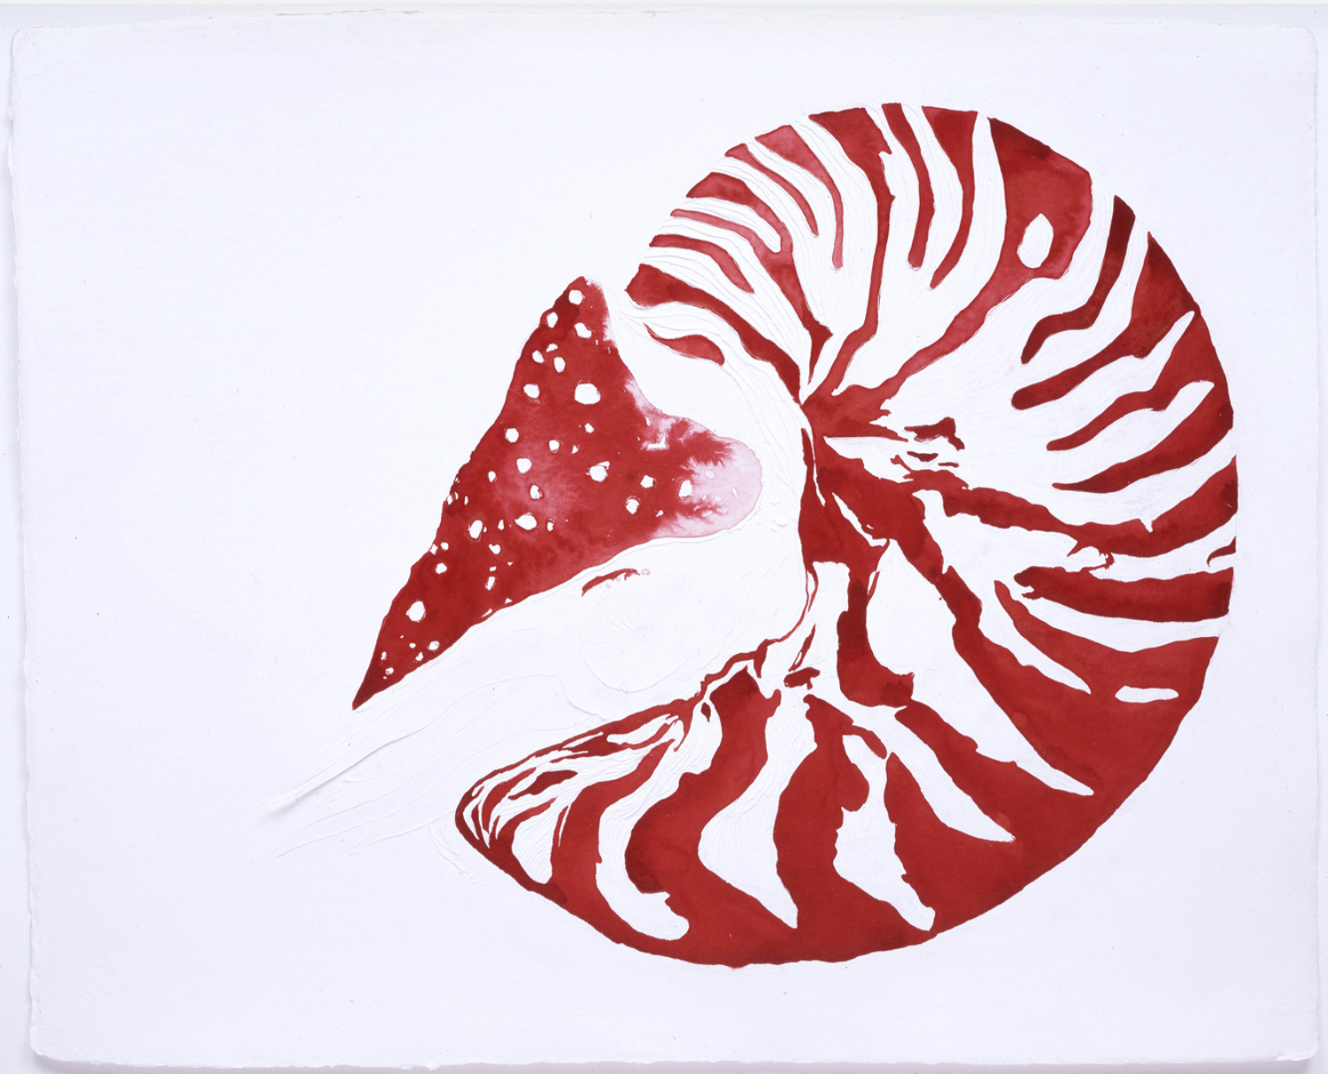
Watery Ecstatic Series
2004
12 drawings: watercolor, ink, oil, pencil and cut paper
dimensions variable
Notes:
Whale carcaces

Slide 10
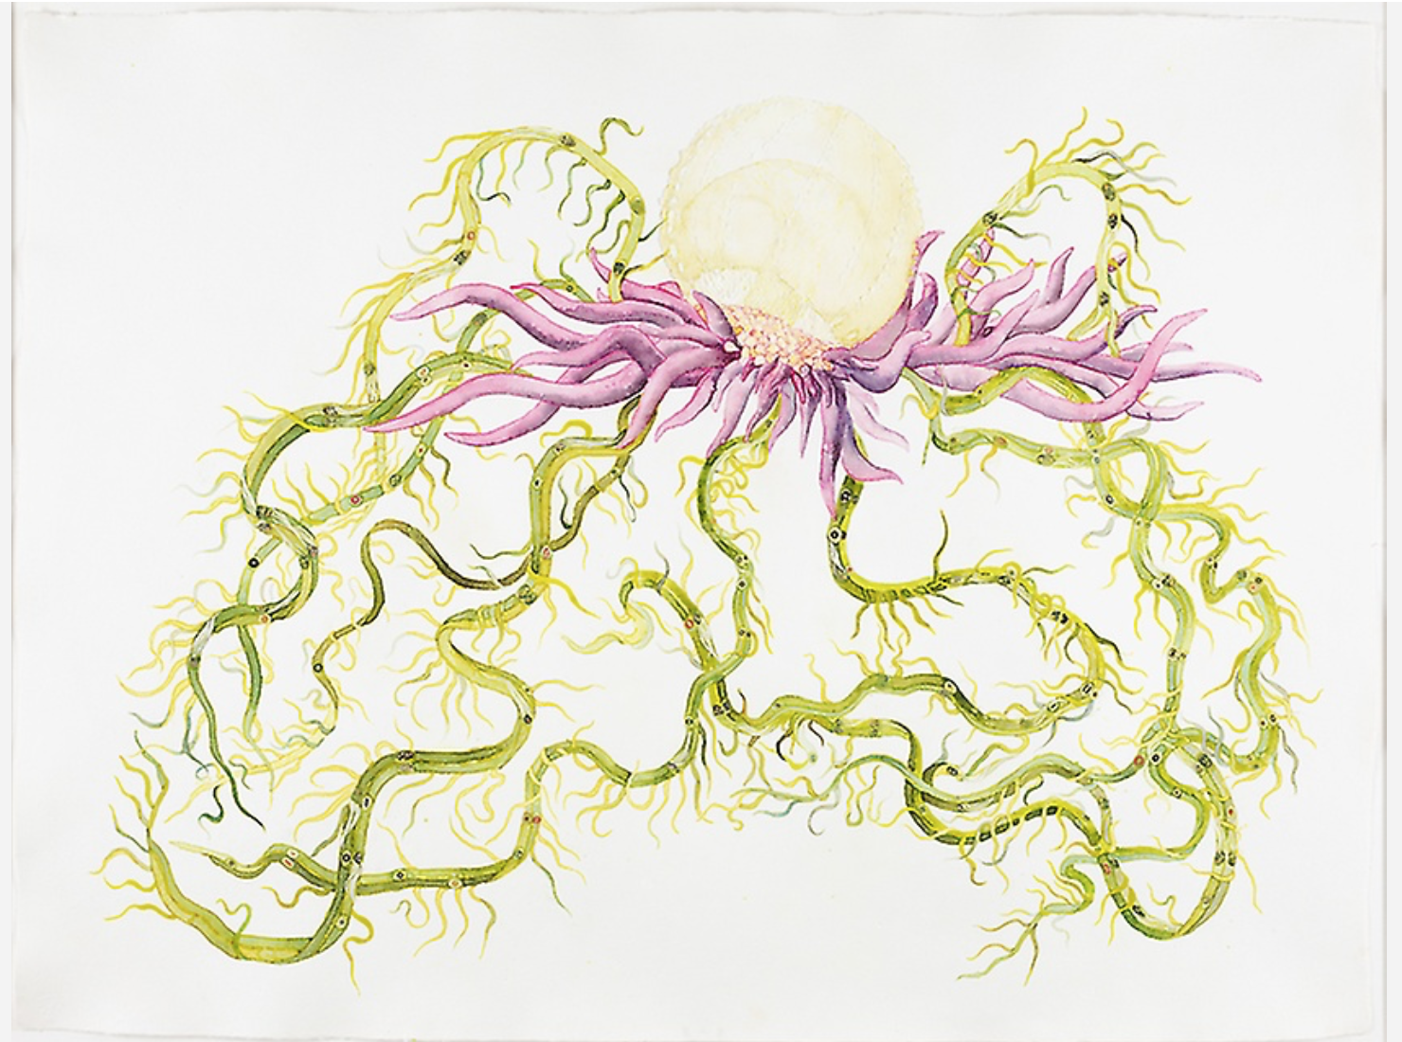
2005; 830 × 1,076 mm
Medium: Watercolor over graphite, with collage and selected varnishing, with cutting and skinning on white wove paper
Notes:
Ellen Gallagher has worked on an ongoing series of mixed media drawings entitled Watery Ecstatic. These works are related to Drexciya, a myth created in 1997 by a Detroit house band of the same name. The musicians imagined an underwater world inhabited by the descendants of pregnant West African women forced from slave ships and lost at sea during the Middle Passage crossing to America. From a distance, the drawing appears abstract, but upon closer inspection, we see that the darker marks are collaged pictures of small black faces that have been affixed to the paper. Their exaggerated lips and distorted, bulging eyeballs evoke minstrel images, the stereotyped physiognomies that Gallagher frequently references in her work. Known for her experimental use of materials, Gallagher carved and cut into the surface of the thick watercolor paper, comparing her process to scrimshaw, the practice of scratching scenes and designs onto the bones, teeth, and tusks of marine mammals.

Slide 11
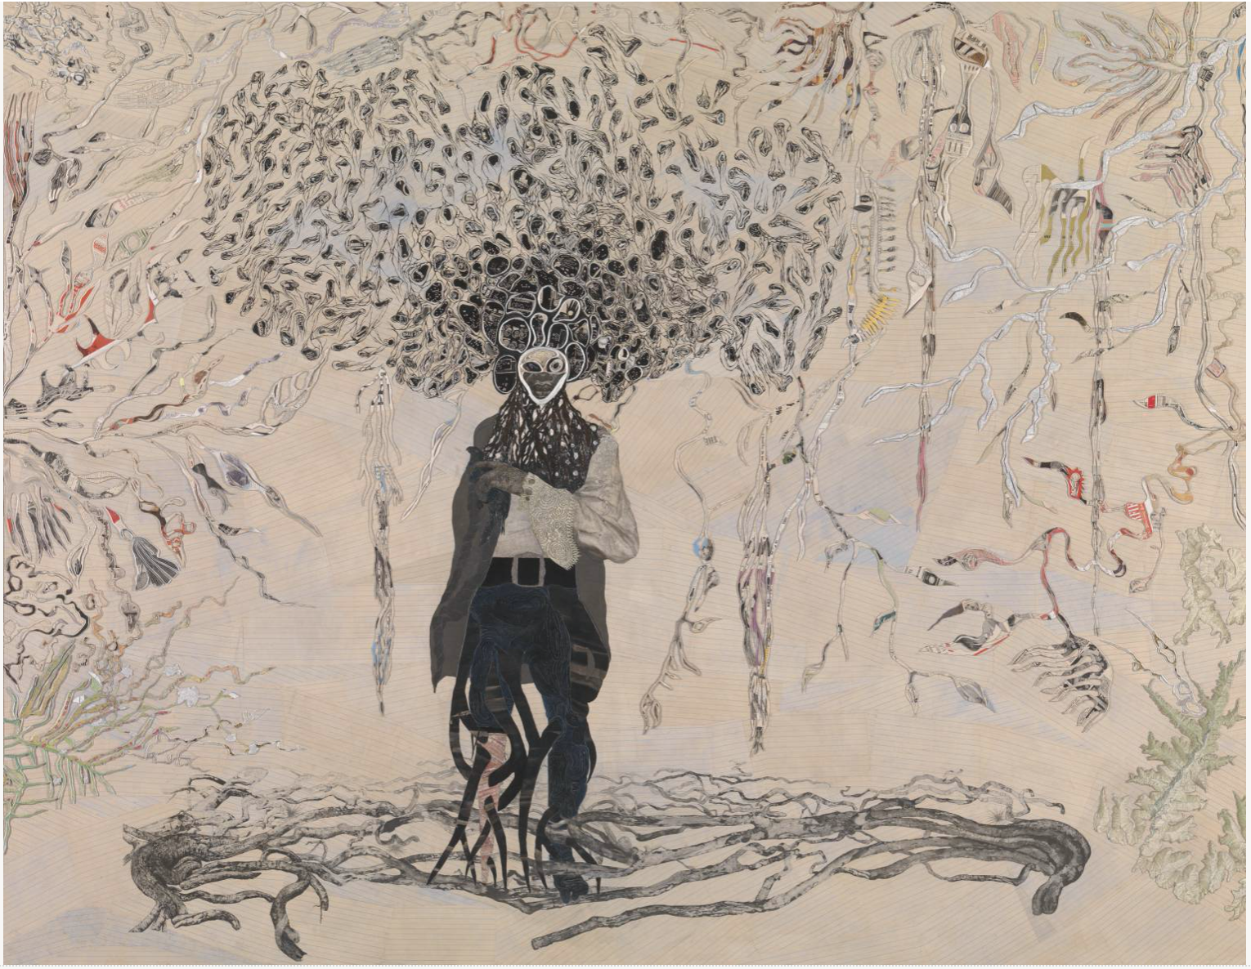
“Bird in Hand”
Oil paint, ink, paper, polymer, salt and gold leaf on canvas
Support: 2383 × 3072 mm
2007
(Pegleg)
Notes:
Gallagher has built up Bird in Hand in layers,depicting a black pirate or sailor holding a parrot, with amorphic swirls around his head transforming into multicolored kelp-like shapes.
applying pieces of printed paper, plasticine, rough rock crystals, silver paint and gold leaf to the canvas support to create a relief. The figure’s hair and the fronds that frame him are made up of layers of paper cut into abstract shapes. Some of the layered areas are up to twenty sheets thick, and, cut from differently coloured pieces of paper, their edges reveal striations of colour. The upper layers show maps, newspaper cuttings and advertisements, particularly for beauty products, such as wigs and skin treatments, aimed at black consumers. Gathering material from black American magazines such as Ebony, Our World and Sepia, is a significant aspect of Gallagher’s technique.

Slide 12
Statements to Conclude
“Ms. Gallagher already loomed large among a generation of young painters who "are converting the rigors of Minimalism into more narrative, subject-driven art."- NyTimes
Journey to Martinique at age 20: “From New England to the carribean you sort of sense this passage of time that is not so great… its immense in the snes you ende dup some place and ended up on a dock where everyone is brown skinned and a variation of brown skin. It’s like I landed on a new planet, I have never seen a brown planet, I've never seen a black nation before... coming form Rhode Island, it’s like I entered… my first experience of Africa and its an exciting feeling to feel connected to places.”- Ellen Gallagher
Notes:
More recently the artist has branched out from painting and collage to film, and from pop-culture imagery to literary and science-fiction references, as exemplified by her last couple of shows at Gagosian.

