Slide 1
Andrea Zittel
Mikhail Kossir

Slide 2
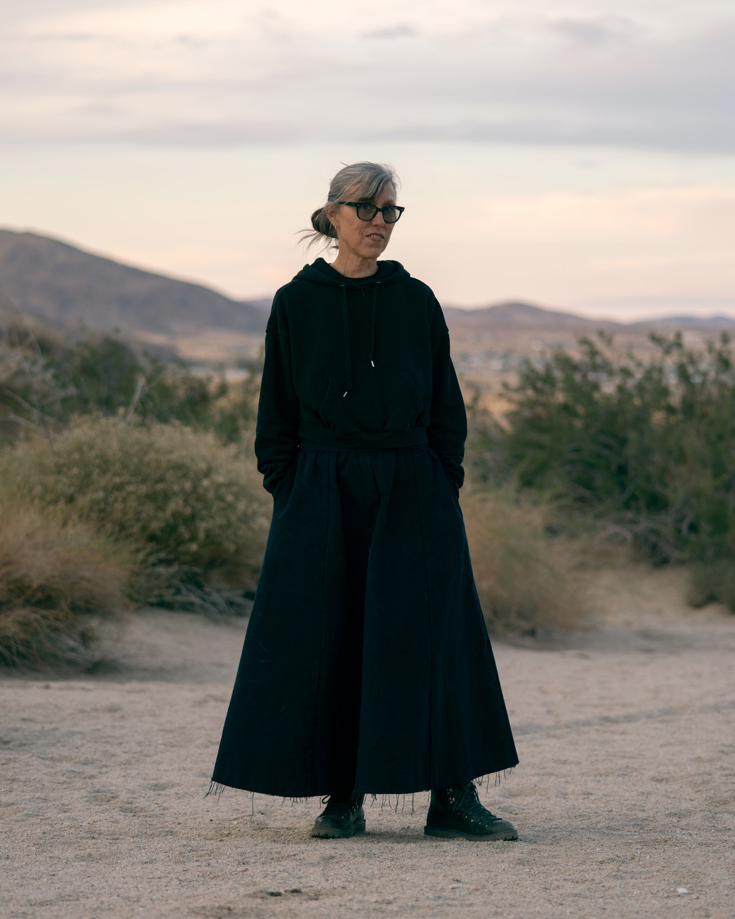
Biography
Born 1965 in Escondido, California.
BFA in painting, San Diego State University, 1988.
MFA in sculpture, RISD, 1990.
“THE INSTITUTE OF INVESTIGATIVE LIVING The A-Z enterprise encompasses all aspects of day to day living. Home furniture, clothing, food all become the sites of investigation in an ongoing endeavor to better understand human nature and the social construction of needs.”
“I am always looking for the gray area between freedom—which can sometimes feel too open-ended and vast—and security—which may easily turn into confinement.

Slide 3
Individual/Community

Slide 4
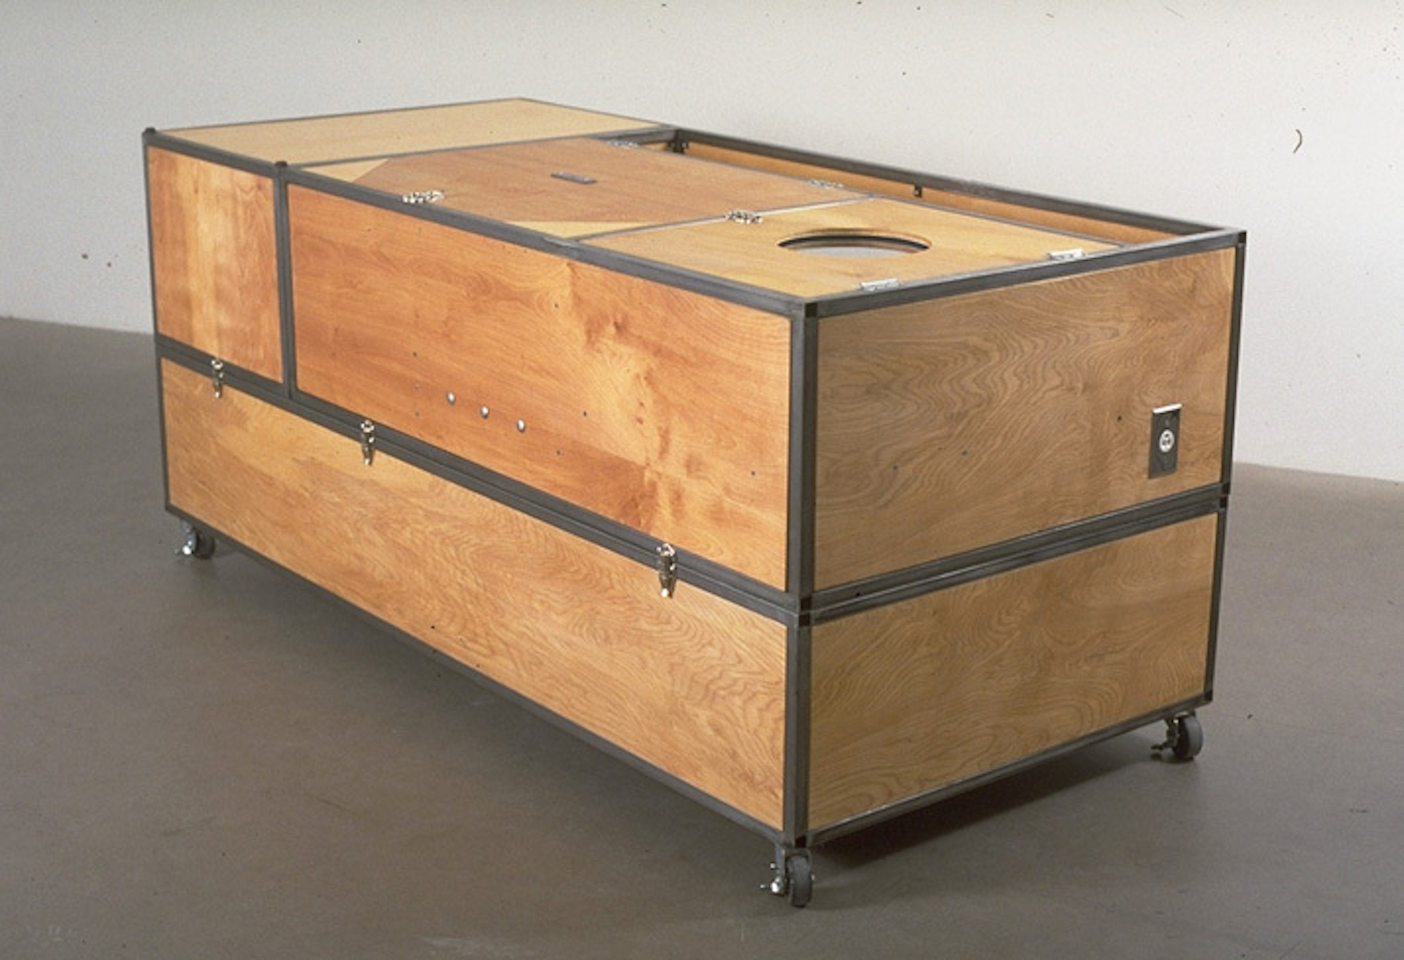
AZ Living Units, 1993

Slide 5
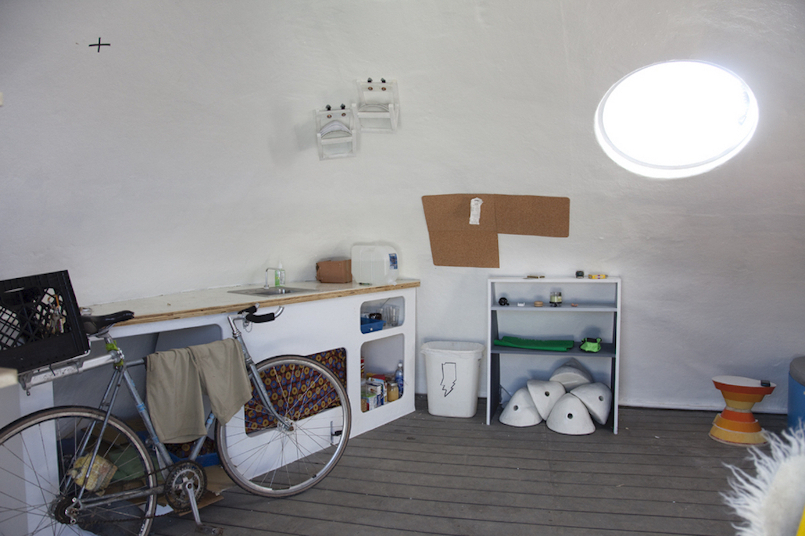
Indy Island, 2009

Slide 6
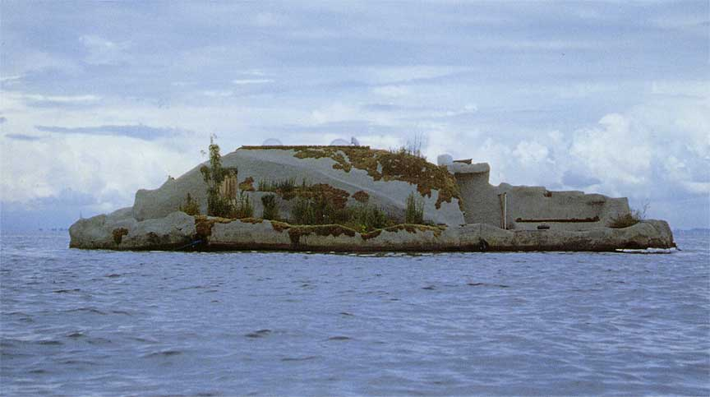
AZ Pocket Property

Slide 7
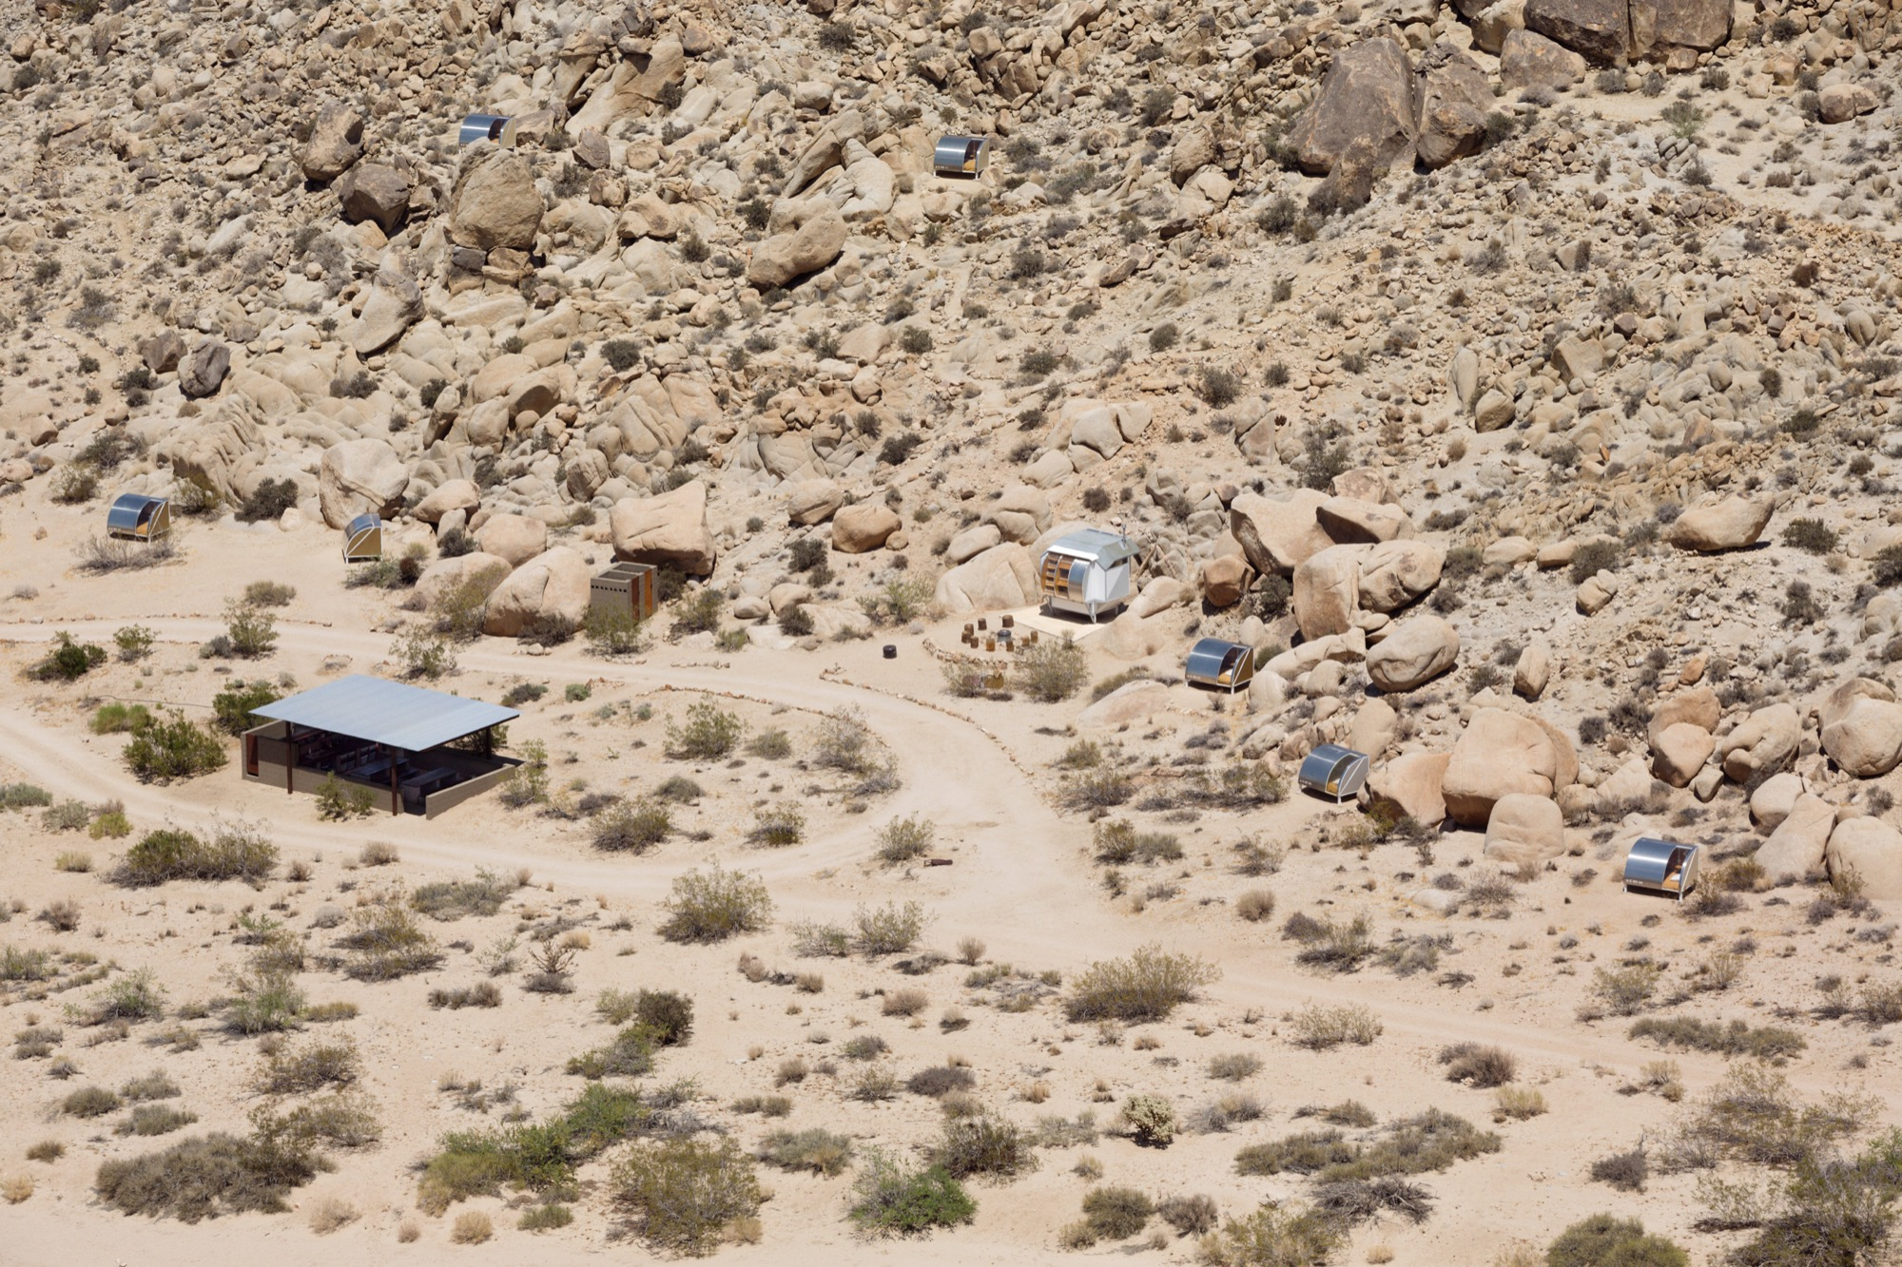
AZ West, 2000
“A-Z West has functioned as an evolving testing grounds for living—a place in which spaces, objects, and acts of living all intertwine into a single ongoing investigation into what it means to exist and participate in our culture today.”
Located in the California high desert next to Joshua Tree National Park, on over 70 acres.

Slide 8
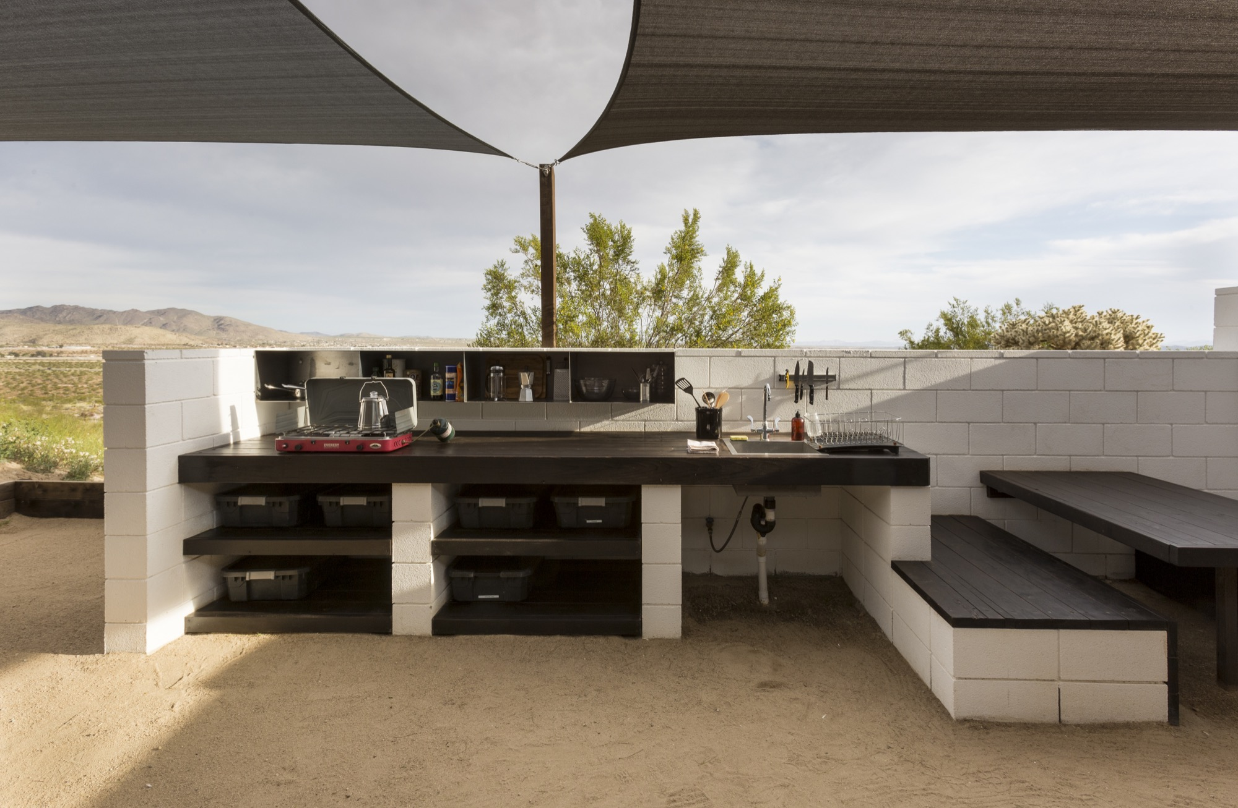
Wagon Station Encampment

Slide 9
European Avant-Garde Inspiration

Slide 10
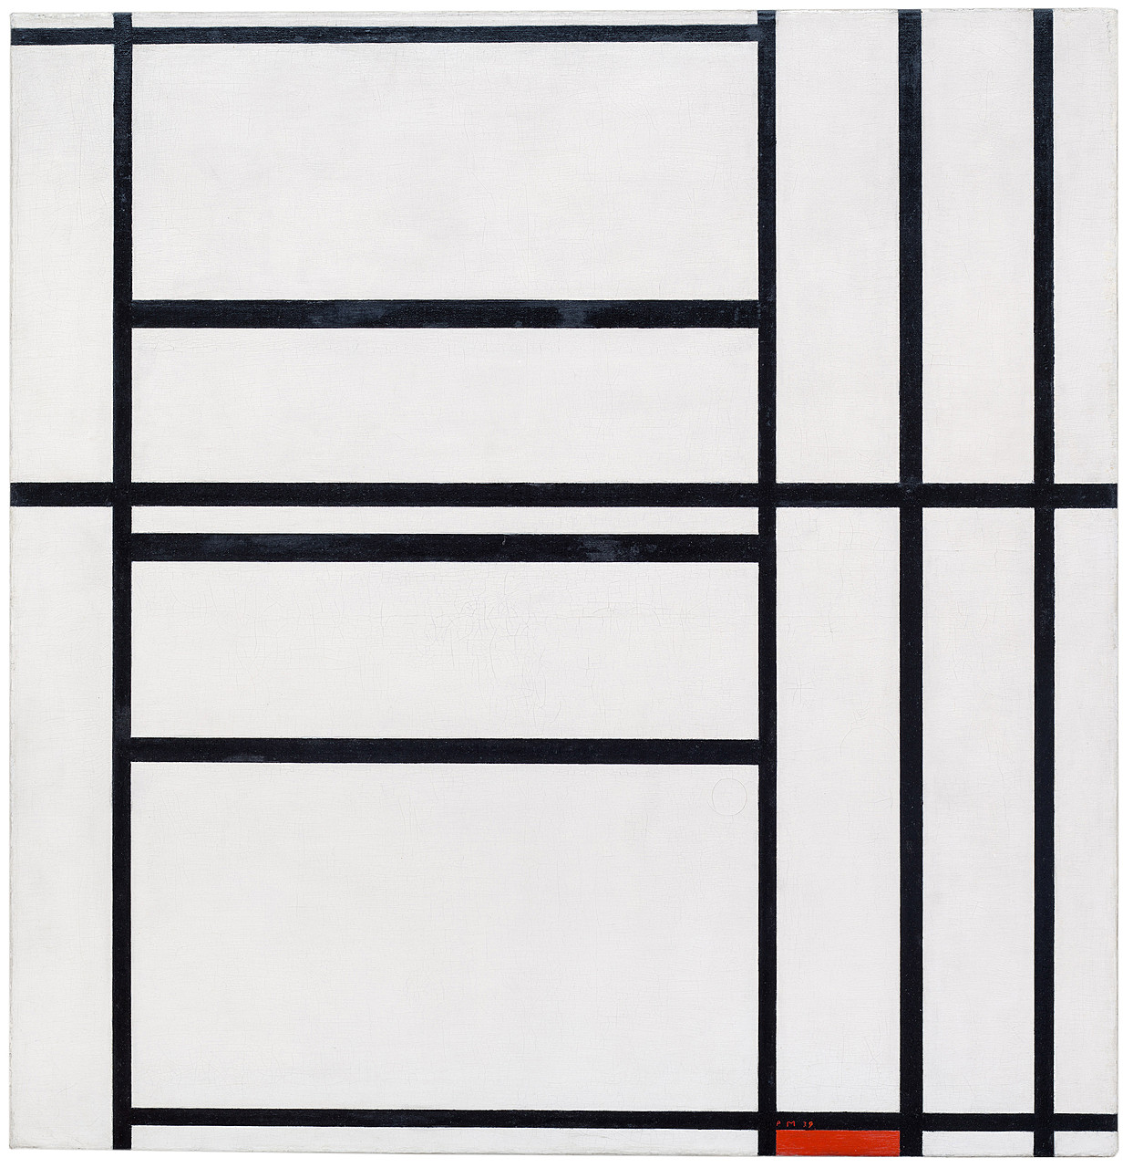
Planar Pavilions, AZ West

Slide 11
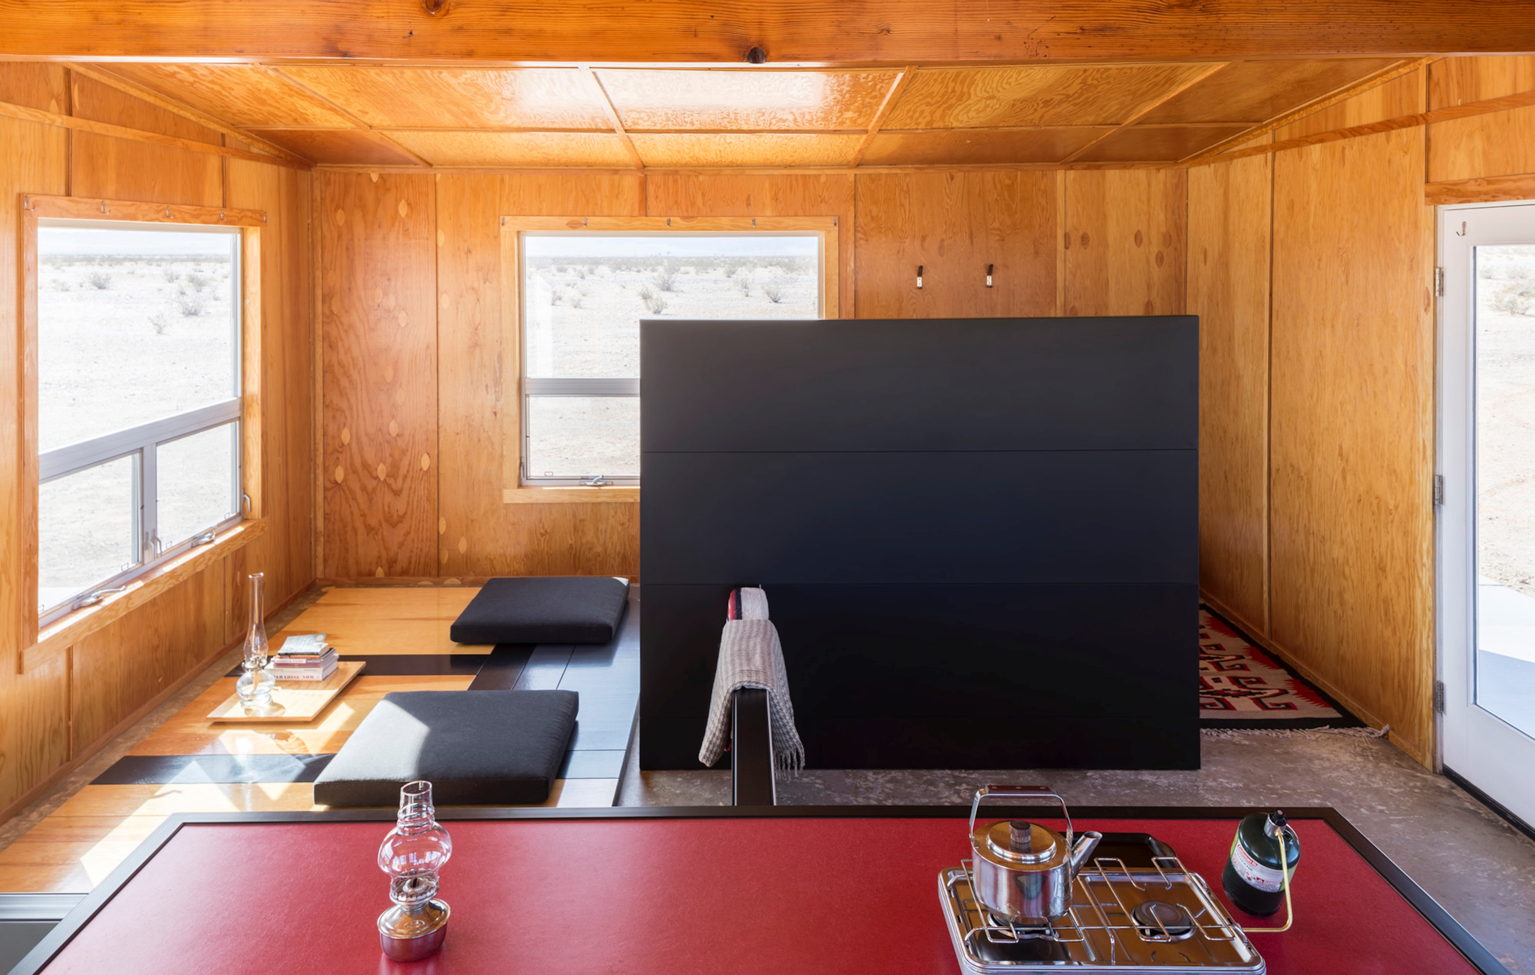
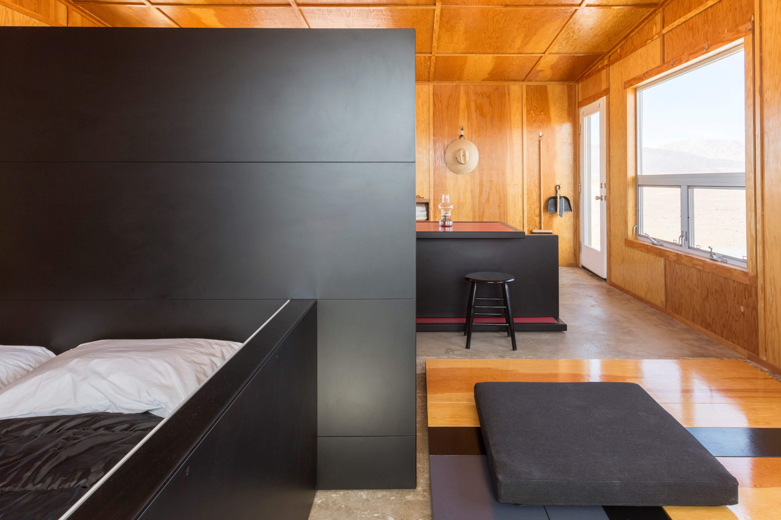
Experimental Living Cabins and Planar Configurations

Slide 12
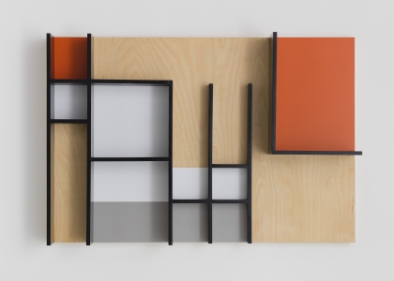
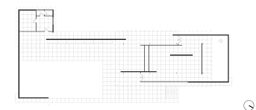
Studies for Planar Configuration, 2017

Slide 13
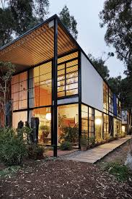
AZ Homestead Units, 2001

Slide 14
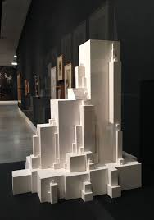
Aggregated Stack, 2011, Berlin

Slide 15
Other Avant-Garde “Geeks”?

